Slide 1

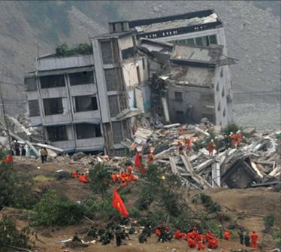
1
Functions and Models
Copyright © Cengage Learning. All rights reserved.

Slide 2
Introduction to calculus
What is calculus and why we study it?
It is extremely difficult to answer this question briefly and convincingly for that world require paraphrasing this entire subject into just a few lines of text. The simplest definition is
“Calculus is the branch of mathematics that involves the rate of change”
1.1
Mathematics: Essentially mathematics is nothing more than the language of science while science is a symmetric study of nature, mathematics is a concise form of communication used to represent nature.

Slide 3
Introduction to calculus
What is meant by change?
Changes are the results of action that comprise a situation. Due to passage of event, some thing must change w.r.t itself. For example a moving objects implies a changing distance covered from a reference point. Or rising temperature implies that the temperature is changed. Change is relative concept that involve any pair of dimension such as time, force, mass, length etc.
1.1
The purpose of studying calculus is simply to introduced your mind to scientific method of analysis and how to apply your mind in a systematic manner towards understanding the world around you. It is used to determine how particles, stars and matter actually move and change in real time.

Slide 4
Introduction to calculus
Branches of calculus
Differential calculus
Integral calculus
Determines the rate of
change of a quantity i.e curves and slope.
Seeks to find the quantity where the rate of change is known. Further it figure out the total size or values i.e length , area, volume.

Slide 5
Introduction to calculus
Who invented Calculus
Calculus was developed in the latter half of the 7th century by two famous mathemations Gottfried Leibnize and Isaac Newton.

Slide 6
Four Ways to Represent a Function
Functions arise whenever one quantity depends on
another. Consider the following four situations.
A. The area A of a circle depends on the radius r of the
circle. The rule that connects r and A is given by the
equation A = π r ². With each positive number r there is
associated one value of A, and we say that A is a
function of r.

Slide 7
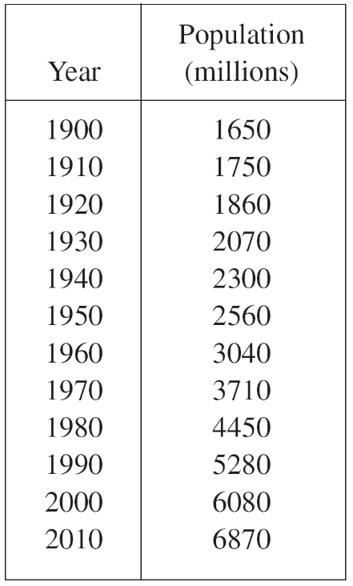
Four Ways to Represent a Function
B. The human population of the world P depends on the time t. The table gives estimates of the world population P (t) at time t, for certain years. For instance,
P(1950) ≈ 2,560,000,000
But for each value of the time t
there is a corresponding value
of P, and we say that P is a function of t.

Slide 8
Four Ways to Represent a Function
C. The cost C of mailing a large envelope depends on the weight w of the envelope. Although there is no simple formula that connects w and C, the post office has a rule for determining C when w is known.
D. The vertical acceleration a of the ground as measured
by a seismograph during an earthquake is a function of
the elapsed time t.

Slide 9
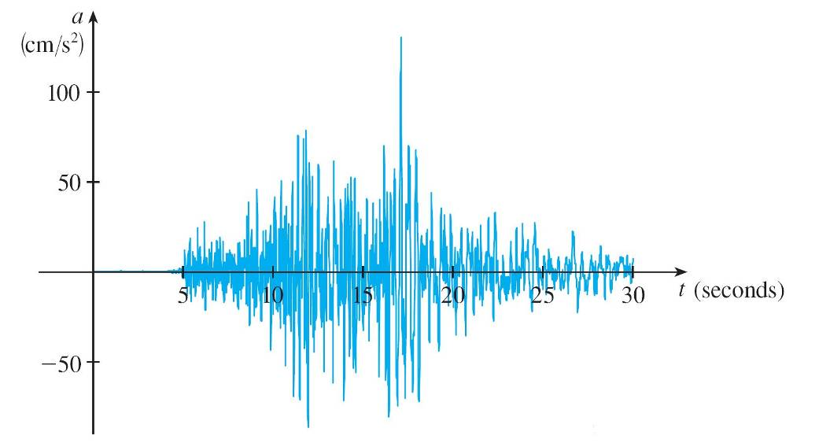
Four Ways to Represent a Function
Figure 1 shows a graph generated by seismic activity
during the Northridge earthquake that shook Los
Angeles in 1994. For a given value of t, the graph
provides a corresponding value of a.
Vertical ground acceleration during the Northridge earthquake
Figure 1

Slide 10
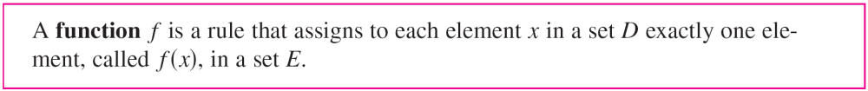
Four Ways to Represent a Function
We usually consider functions for which the sets D and E are sets of real numbers. The set D is called the domain of the function.
The number f (x) is the value of f at x and is read “f of x.” The range of f is the set of all possible values of f (x) as x varies throughout the domain.
A symbol that represents an arbitrary number in the domain of a function f is called an independent variable.

Slide 11
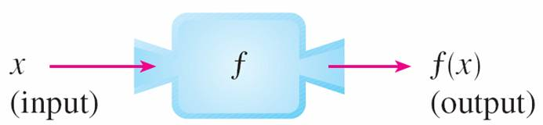
Four Ways to Represent a Function
A symbol that represents a number in the range of f is called a dependent variable. In Example A, for instance, r is the independent variable and A is the dependent variable.
It’s helpful to think of a function as a machine
(see Figure 2).
Machine diagram for a function f
Figure 2

Slide 12
Four Ways to Represent a Function
If x is in the domain of the function f, then when x enters the machine, it’s accepted as an input and the machine produces an output f (x) according to the rule of the function.
Thus we can think of the domain as the set of all possible inputs and the range as the set of all possible outputs.

Slide 13
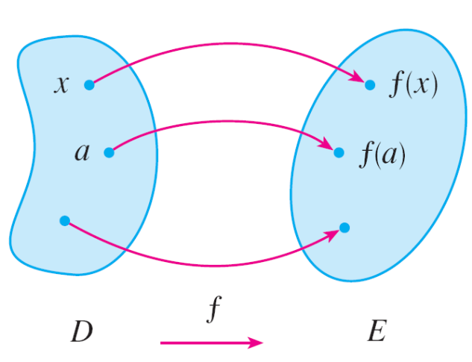
Four Ways to Represent a Function
Another way to picture a function is by an arrow diagram as in Figure 3.
Each arrow connects an element of D to an element of E. The arrow indicates that f (x) is associated with x, f (a) is associated with a, and so on.
Arrow diagram for f
Figure 3

Slide 14
Four Ways to Represent a Function
The most common method for visualizing a function is its graph. If f is a function with domain D, then its graph is the set of ordered pairs
{(x, f (x)) | x ∈ D}
In other words, the graph of f consists of all points (x, y)
in the coordinate plane such that y = f (x) and x is in the domain of f.
The graph of a function f gives us a useful picture of the behavior or “life history” of a function.

Slide 15
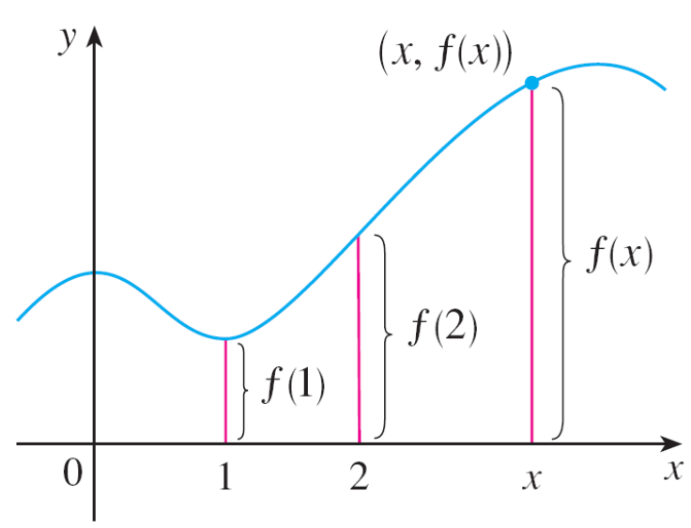
Four Ways to Represent a Function
Since the y-coordinate of any point (x, y) on the graph is
y = f (x), we can read the value of f (x) from the graph as being the height of the graph above the point x
(see Figure 4).
Figure 4

Slide 16
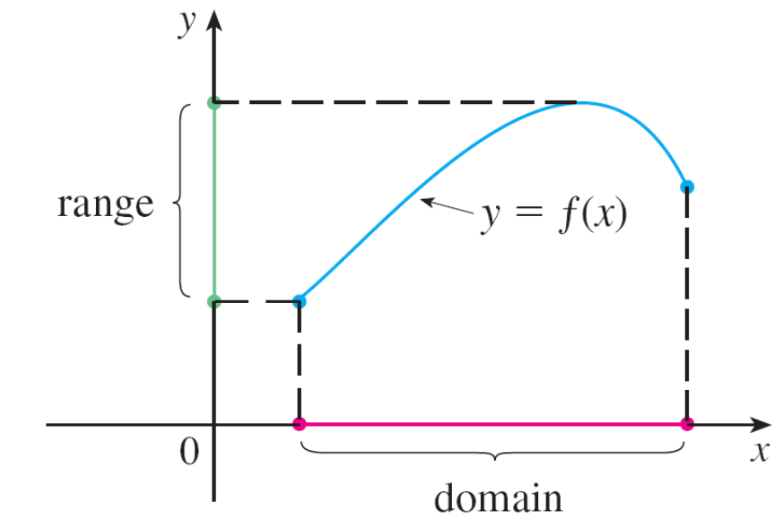
Four Ways to Represent a Function
The graph of f also allows us to picture the domain of f on the x-axis and its range on the y-axis as in Figure 5.
Figure 5

Slide 17
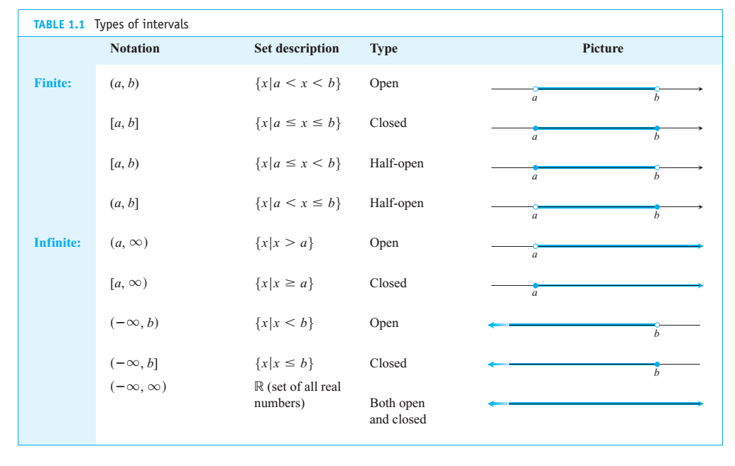
Types of intervals

Slide 18
Representations of Functions
There are four possible ways to represent a function:
verbally (by a description in words)
numerically (by a table of values)
visually (by a graph)
algebraically (by an explicit formula)

